Slide 1

Hamburger
Delivery
Order
System
2014112498 Lim Sehun

Slide 2
CONTENTS
01
02
03
04
05
Introduction
Purpose
Modeling
UI (Customer)
UI (Admin)
1) Use Case
2) EFD
1) Index
2) Menu
3) Location
4) Order (Non-member)
5) Order view
(Non-member)
6) Login & Register
7) Index (Member)
8) My page
9) Order & Order view
1) Index (Admin)
2) Menu management
3) Customer data
4) Order Check

Slide 3
01
Introduction
Hamburger Delivery Order System
<Customer>
- Use google map to locate the store
- Order (Member / Non-member)
- Check my order / Cancel the order
- My Information
(check, modify, withdrawal)
<Administrator>
- Manage the menu
(add, modify, delete)
- Check order
(Member / Non-member)
- Check Information of members

Slide 4
02
Purpose
<Customer>
Check the location of the store close to you
Easy to order
<Administrator>
Check order
Customer management

Slide 5
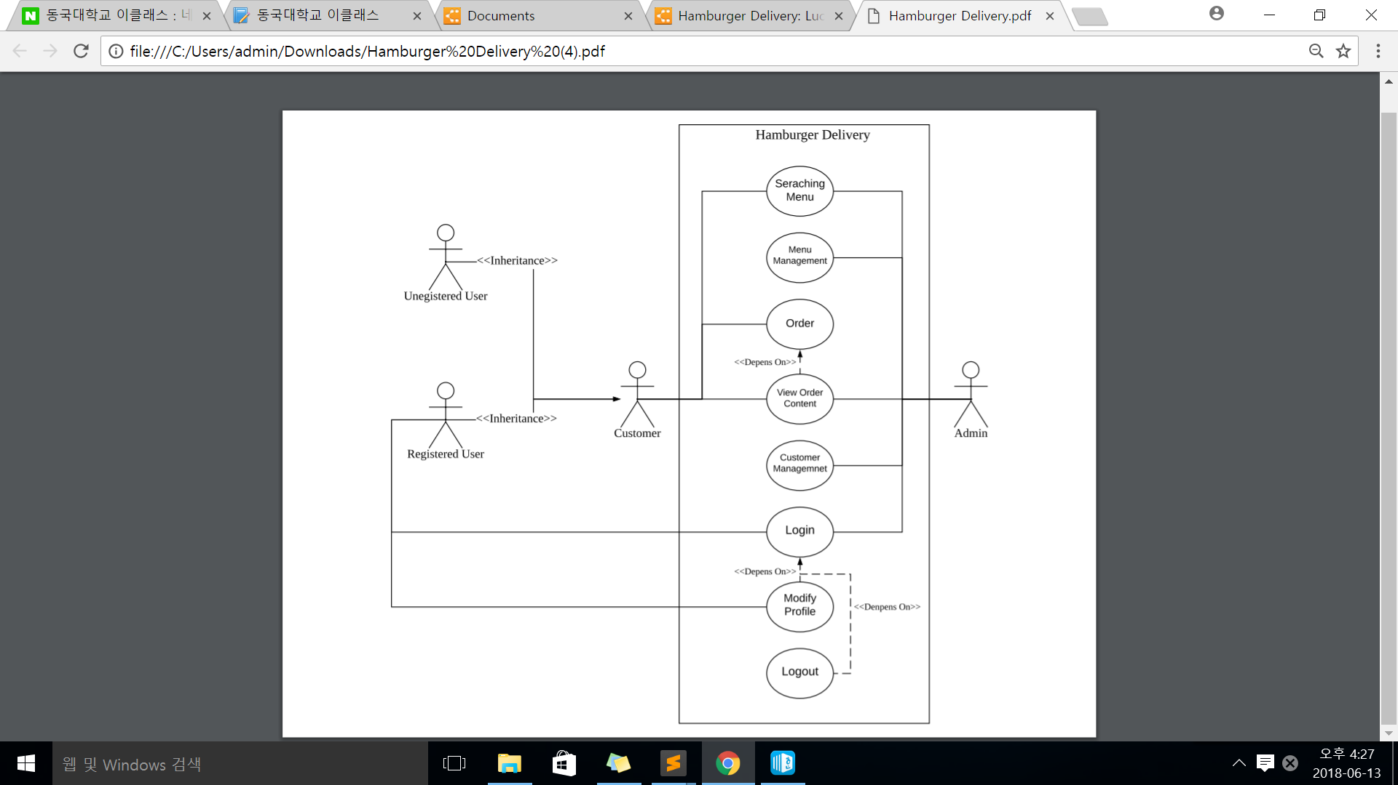
03
Modeling
1. Use Case

Slide 6
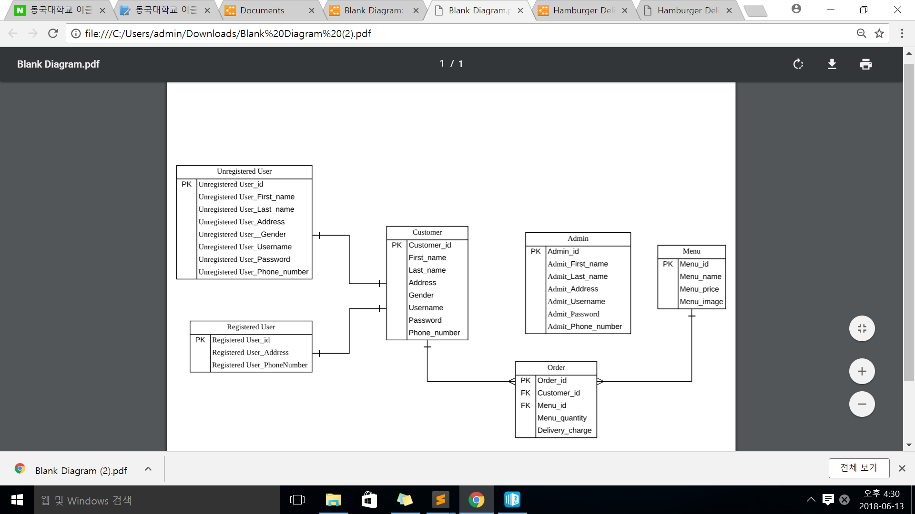
03
Modeling
2. ERD

Slide 7
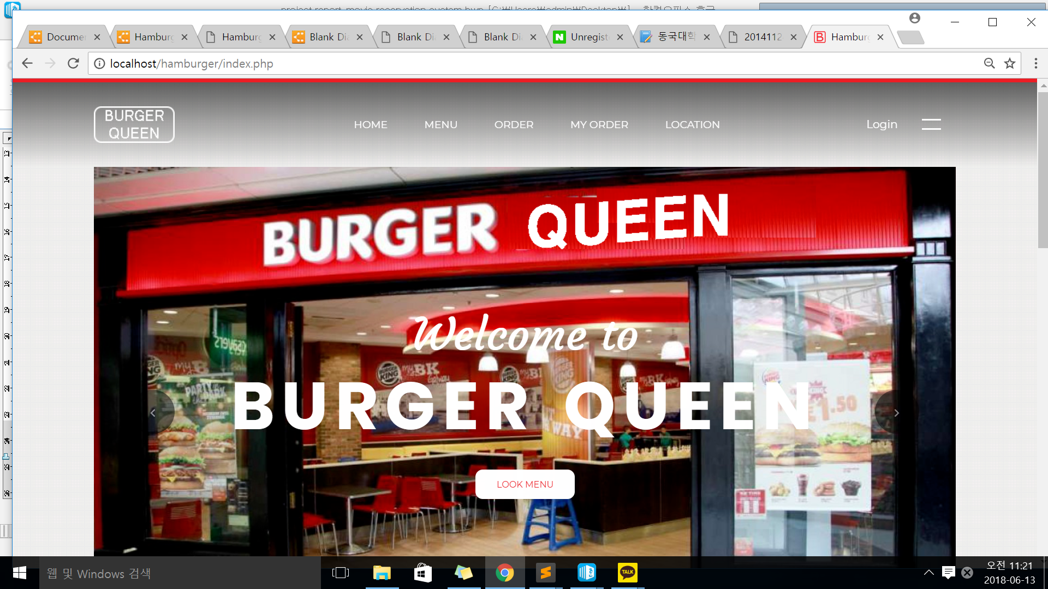
04
UI (Customer)
1. Index

Slide 8
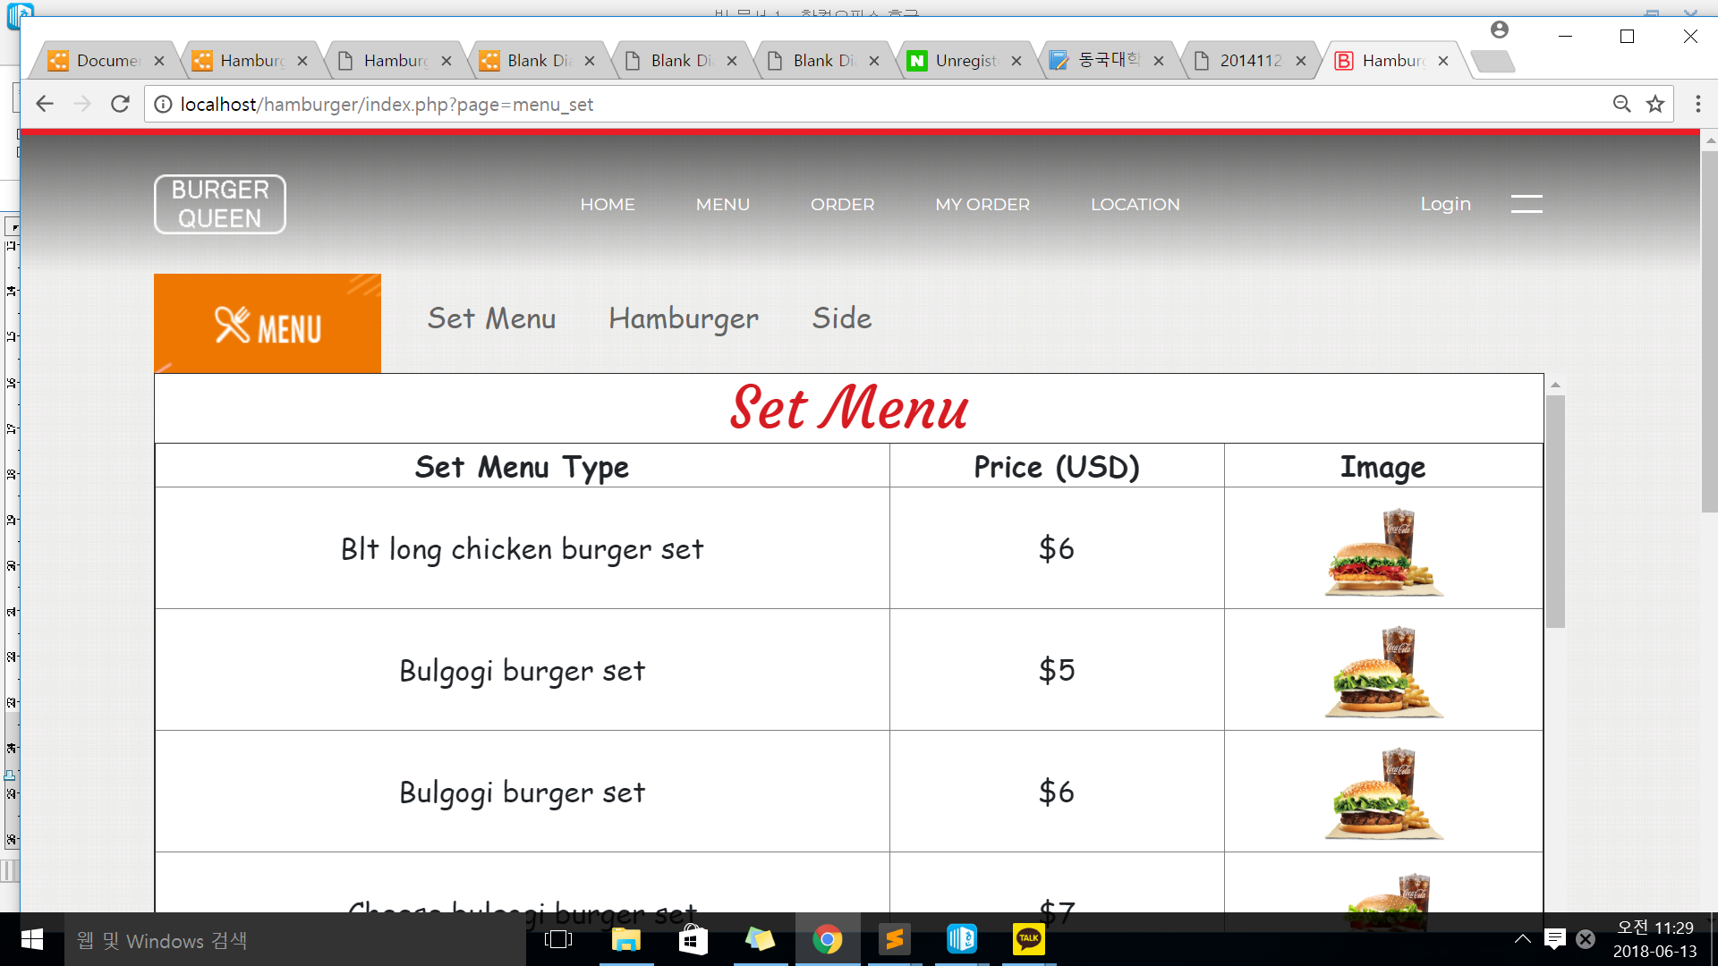
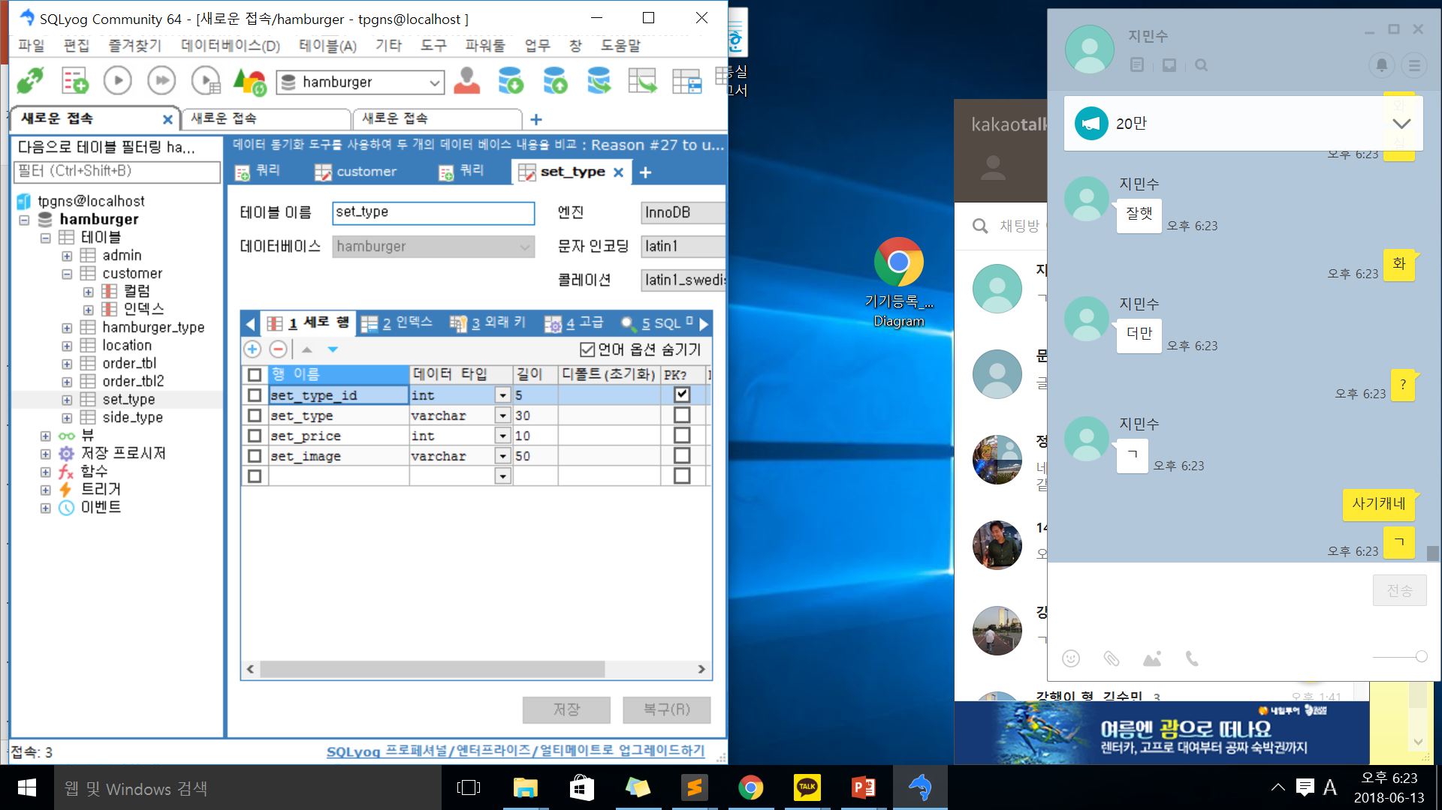
04
UI (Customer)
2. Menu

Slide 9
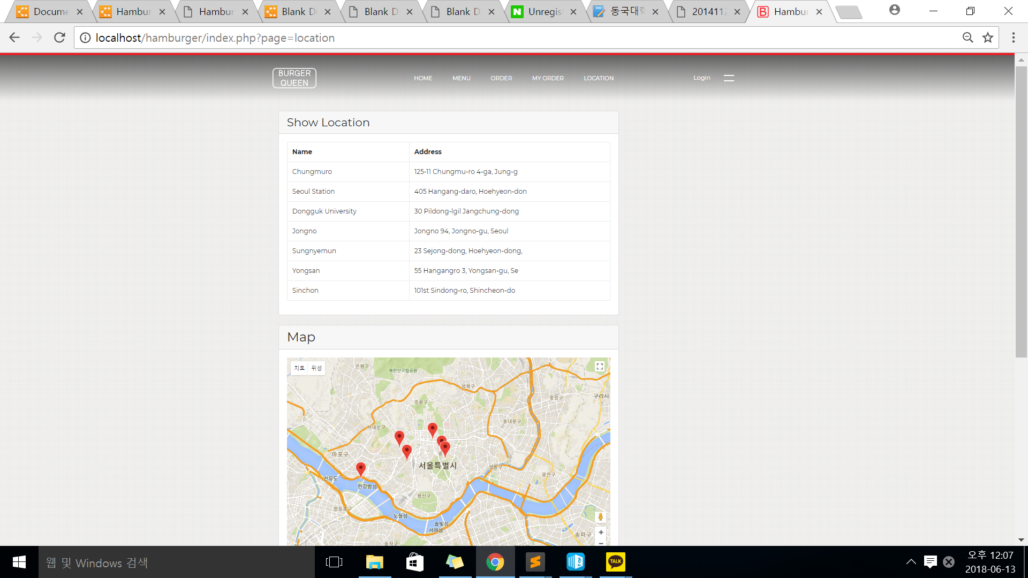
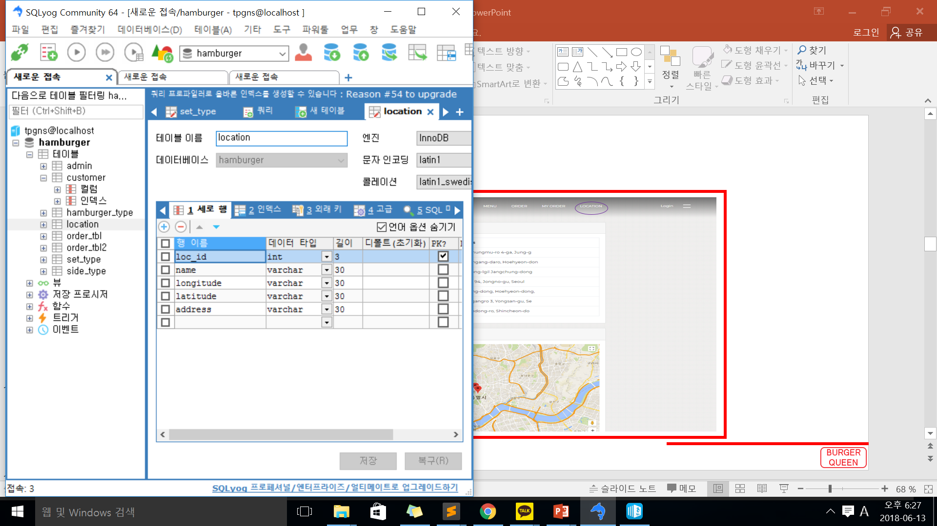
04
UI (Customer)
3. Location

Slide 10
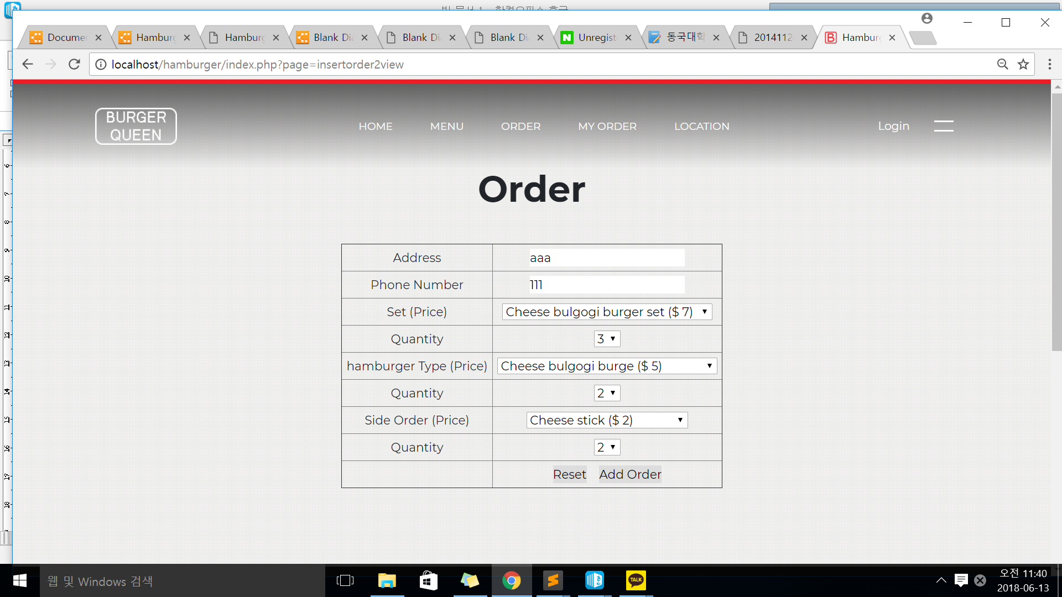
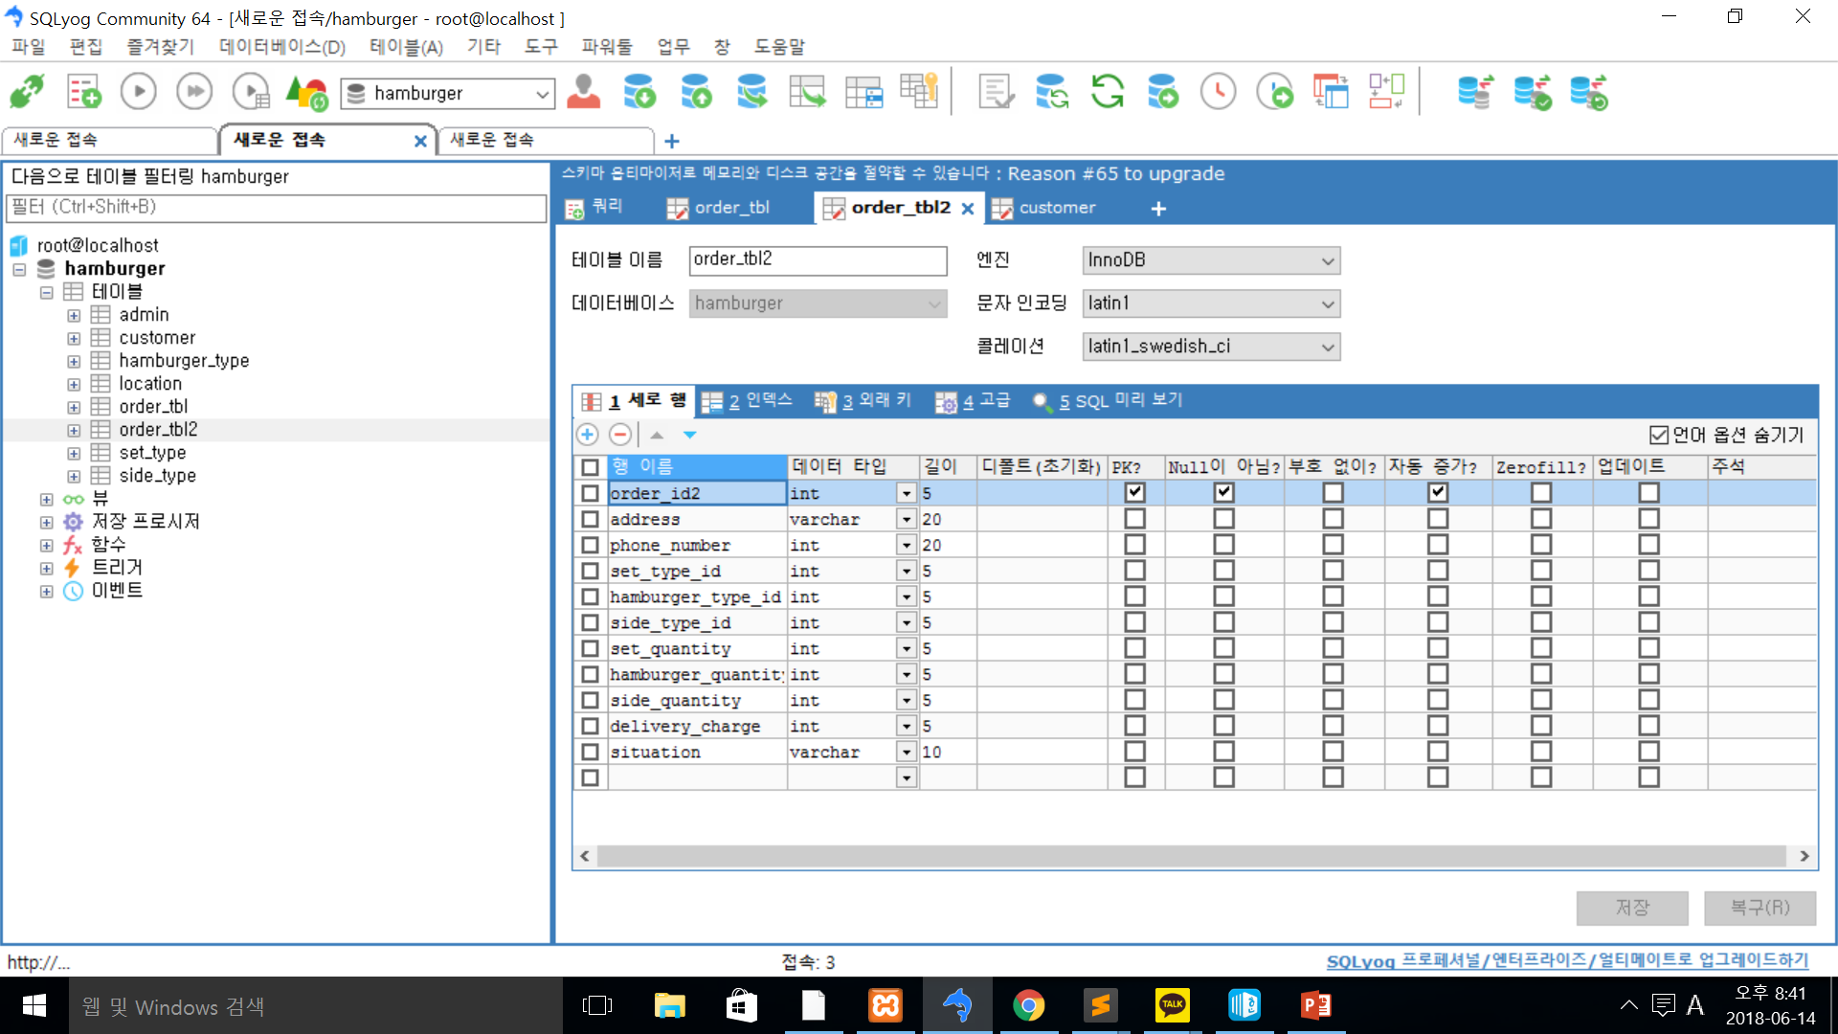
04
UI (Customer)
4. Order (Non-member)
* Hypothesis : You must order set, hamburger, and side all.
* You Can enter only numbers in the Phone Number box.

Slide 11
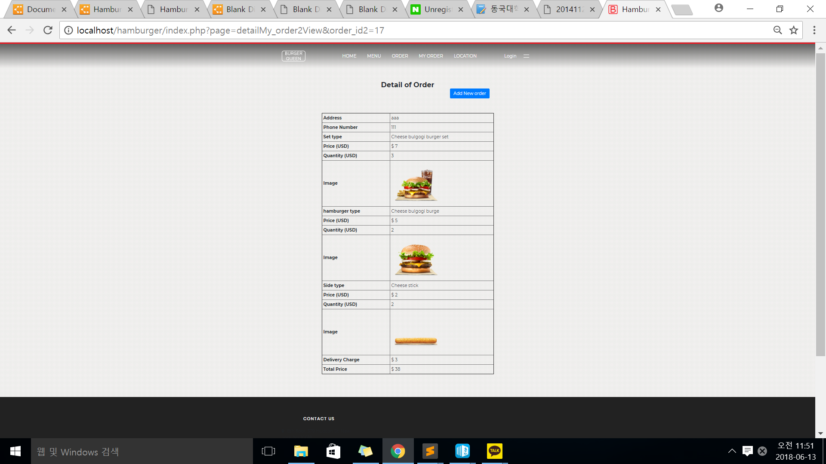
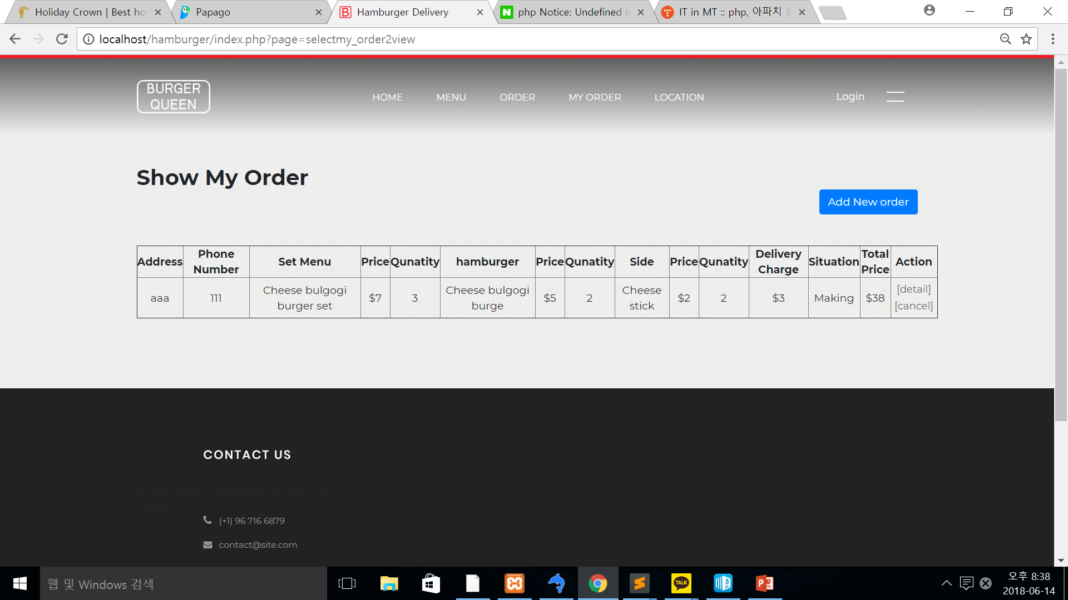
04
UI (Customer)
5. Order View (Non-member)
Total Price : Set Price*Quantity + hamburger Price*Quantity + Side Price *Quantity + Delivery Charge

Slide 12
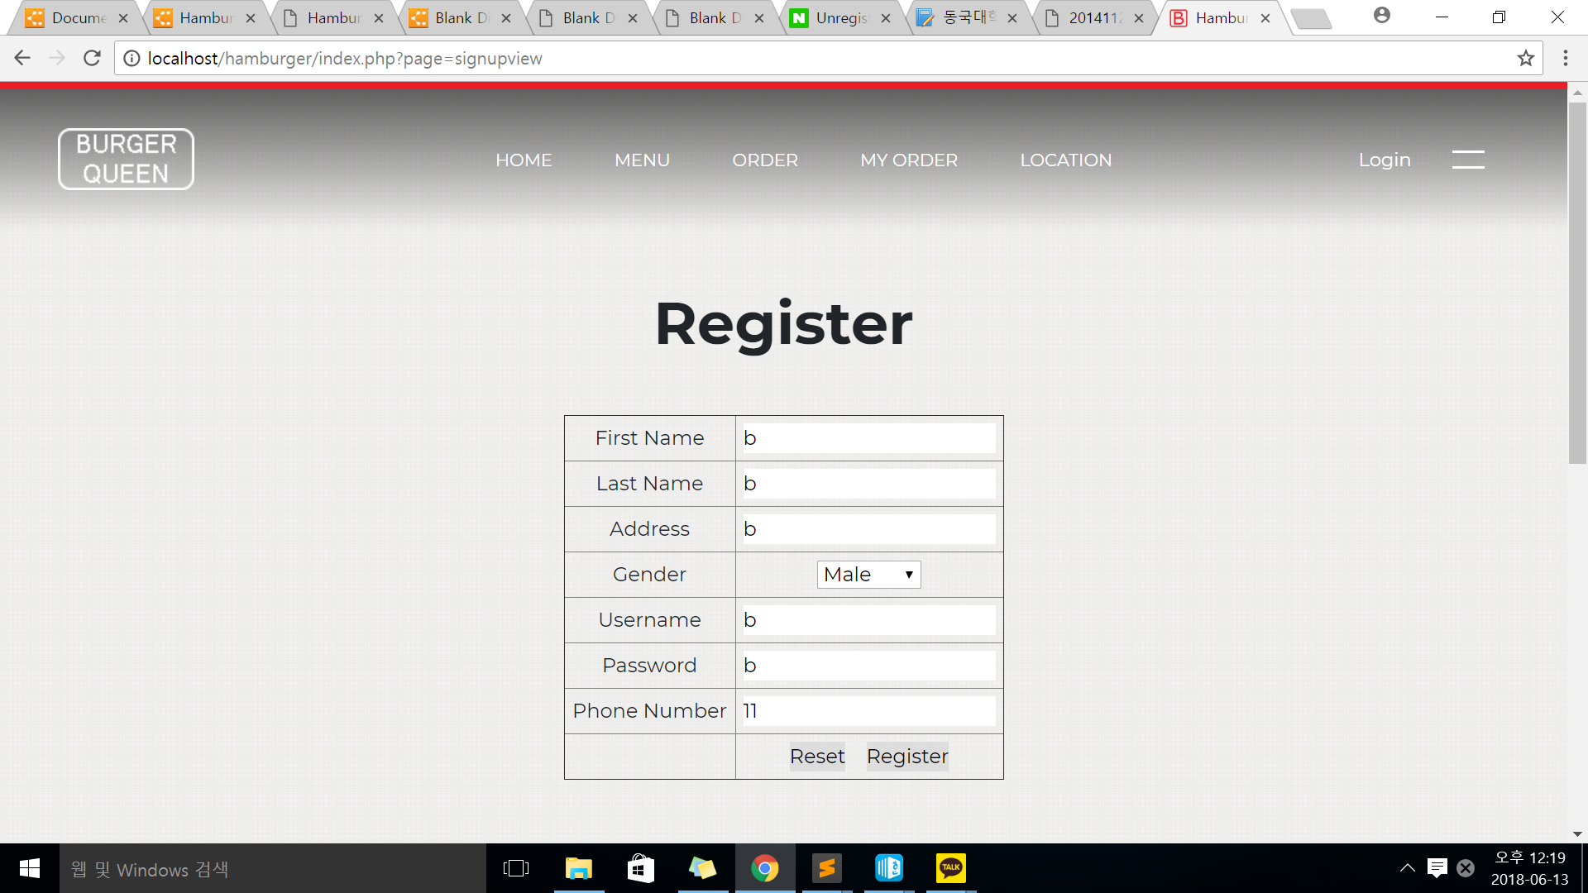
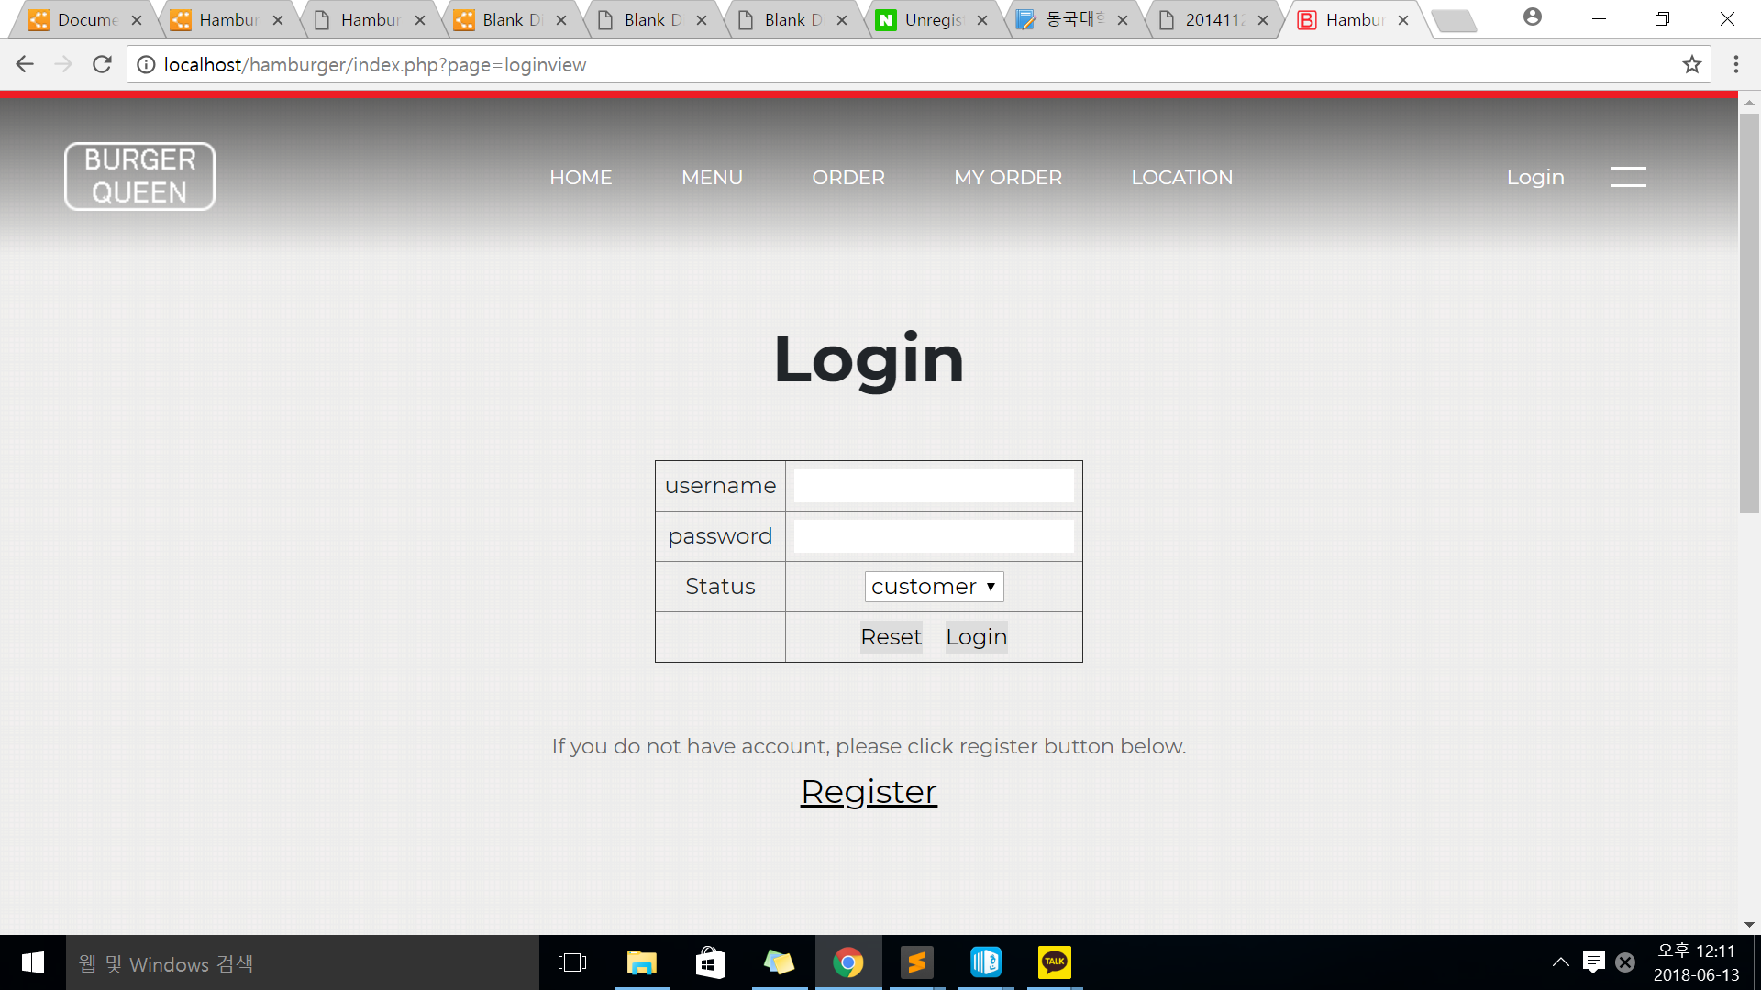
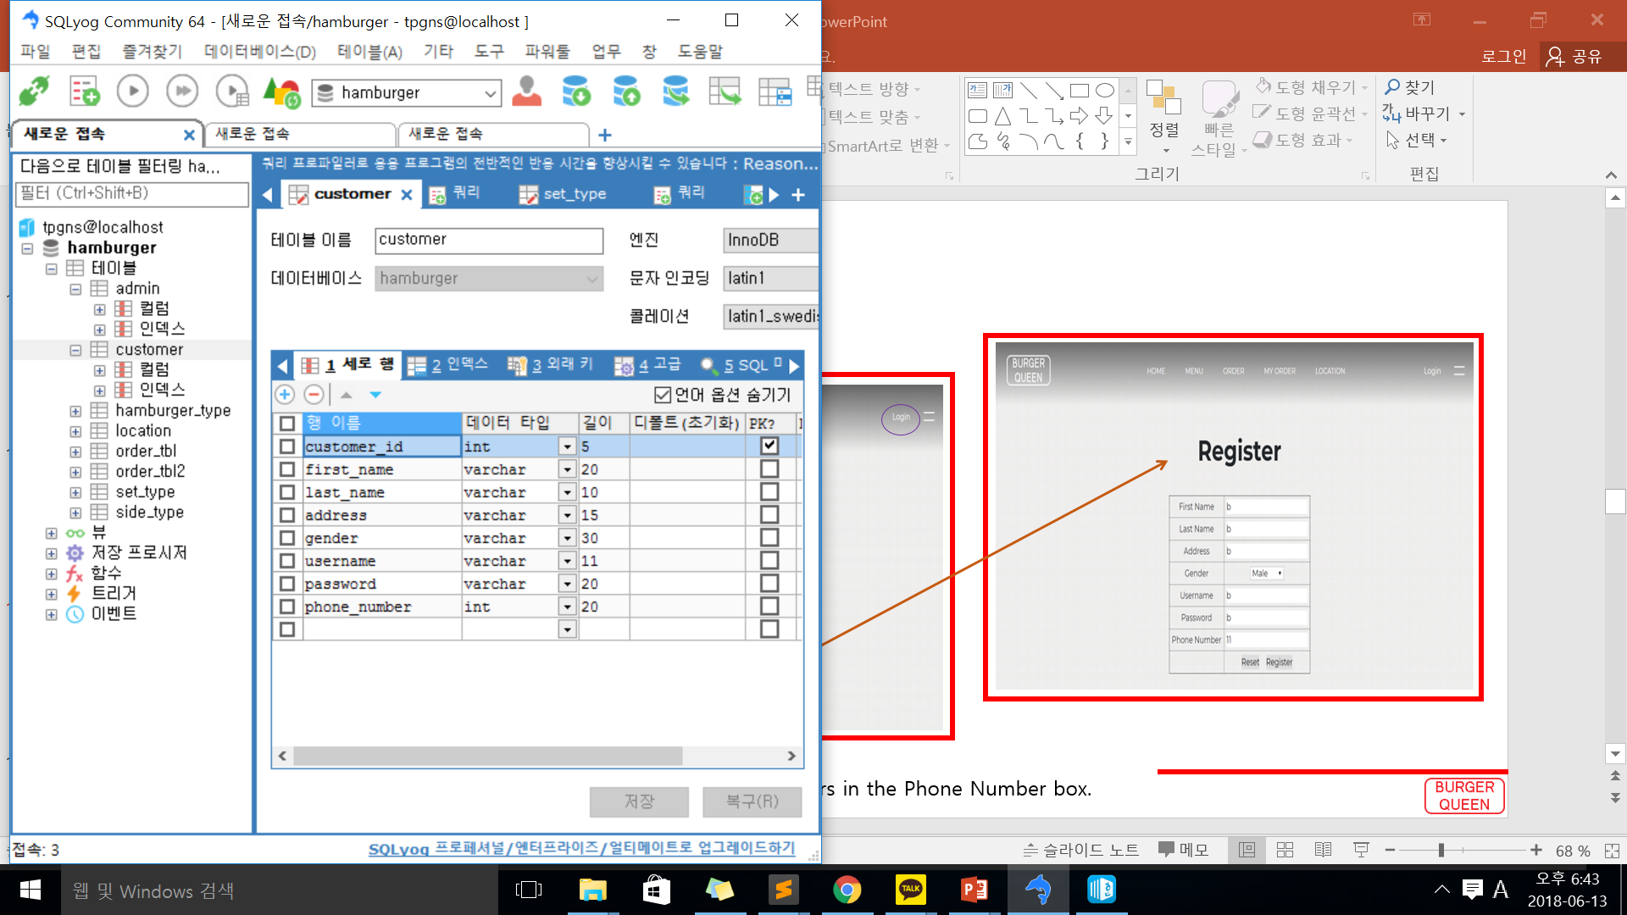
04
UI (Customer)
6. Login & Register
PK
* You can enter only numbers in the Phone Number box.

Slide 13
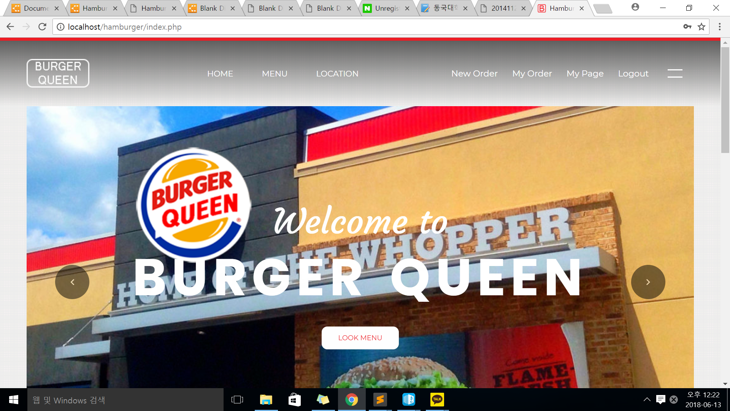
04
UI (Customer)
7. Index (Member)

Slide 14
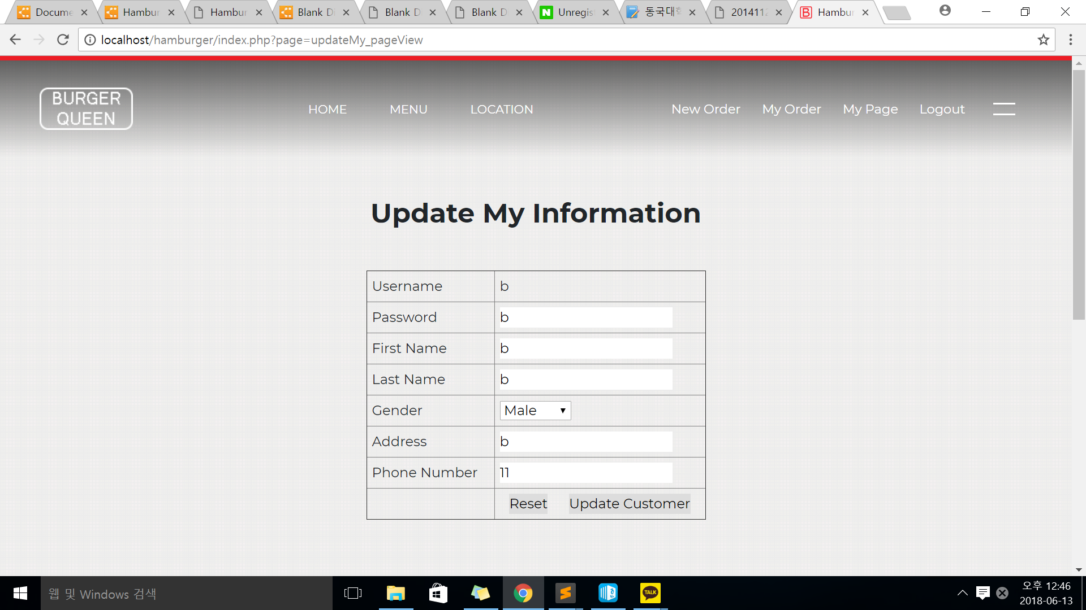
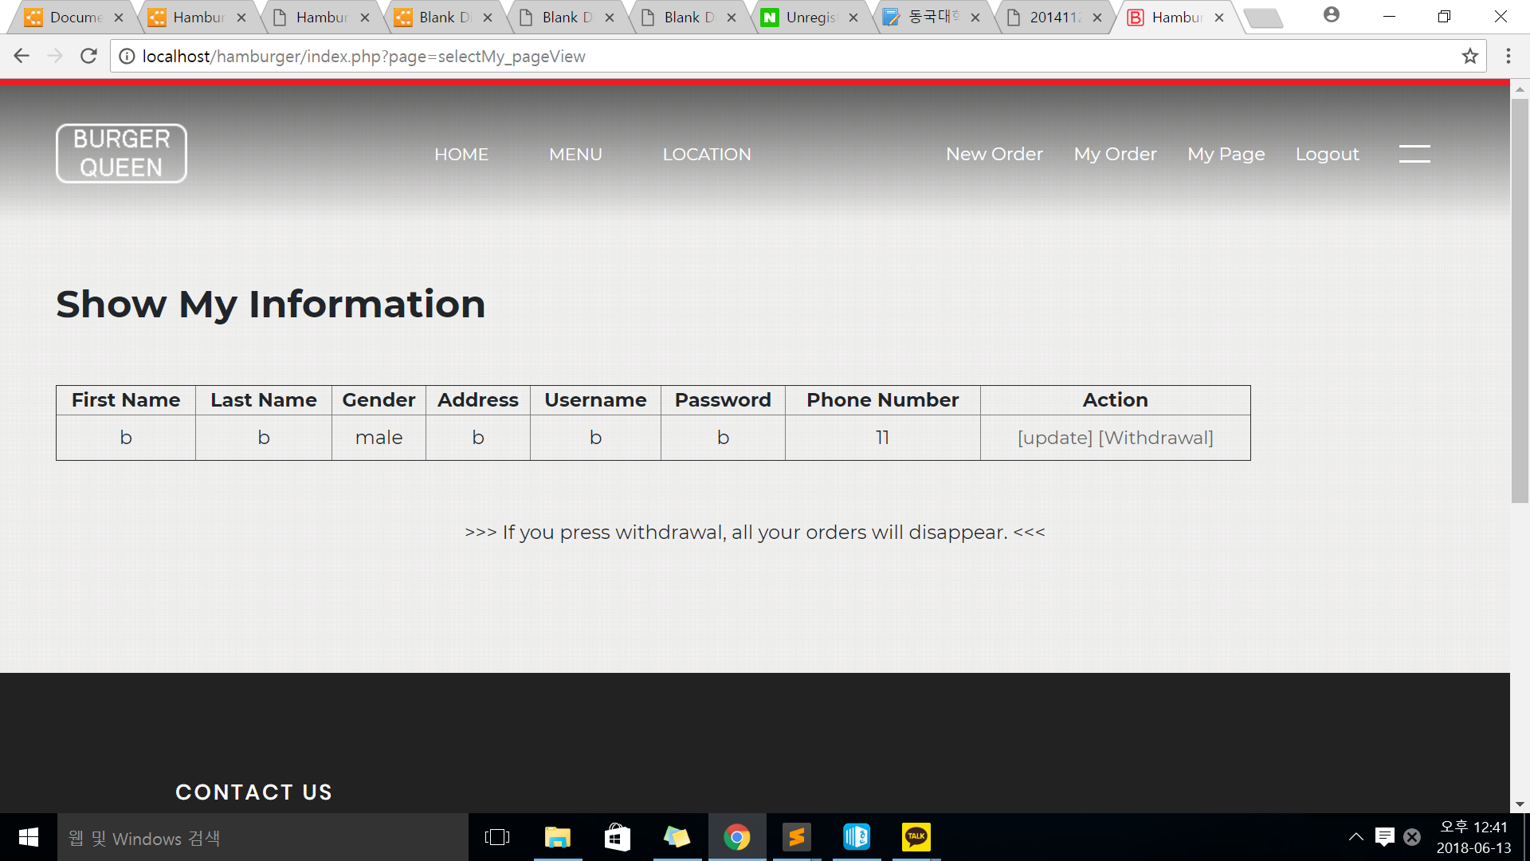
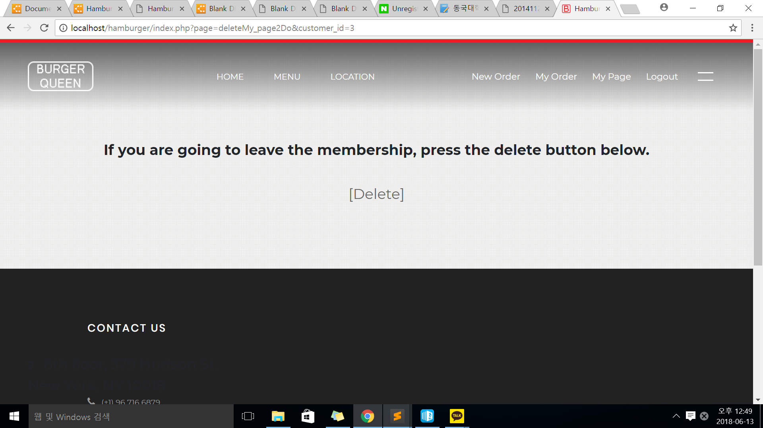
04
UI (Customer)
8. My page
If you press the [Delete] button, you can leave the membership and go to the home screen.

Slide 15
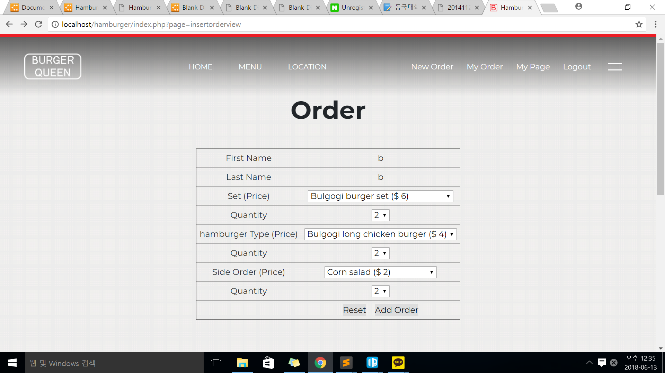

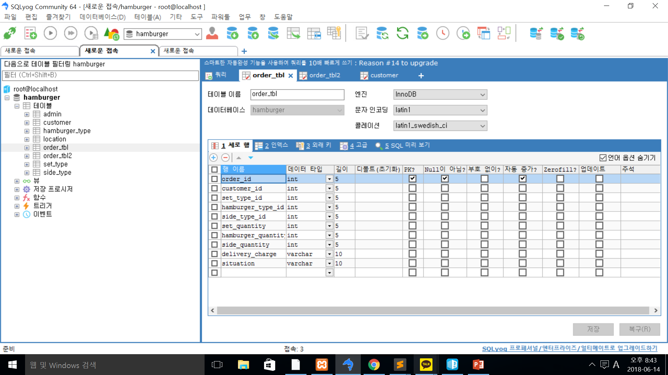
04
UI (Customer)
9. Order & Order view
* Hypothesis : You must order set, hamburger, and side all.
FK
Int (Non-member ) -> varchar

Slide 16
04
UI (Customer)
10. Order View
Total Price : Set Price*Quantity + hamburger Price*Quantity + Side Price *Quantity
* Delivery Charge = Free

Slide 17
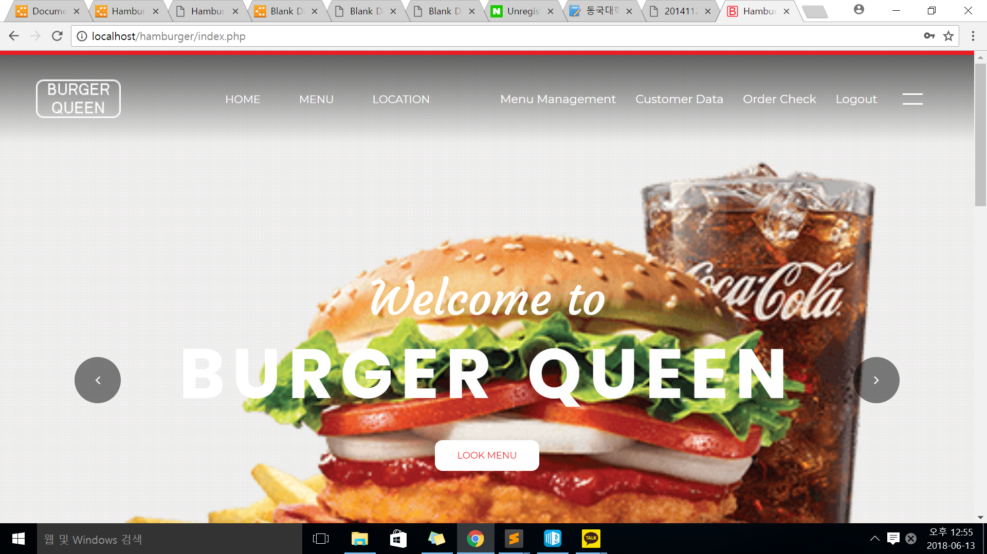
05
UI (Admin)
1. Index (Admin)

Slide 18
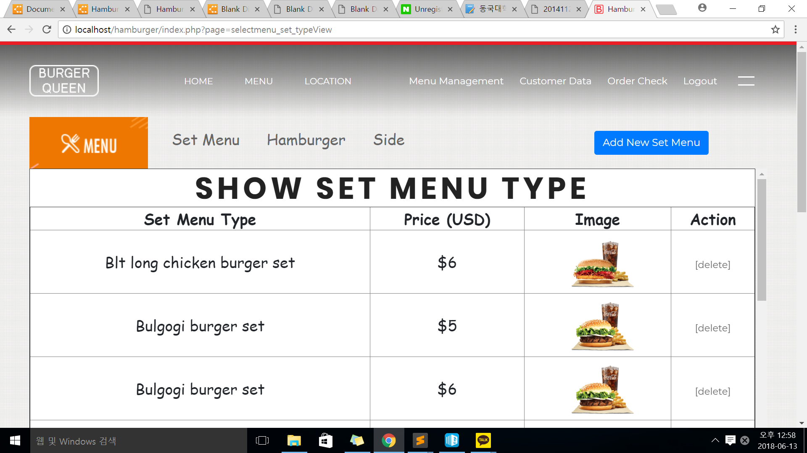
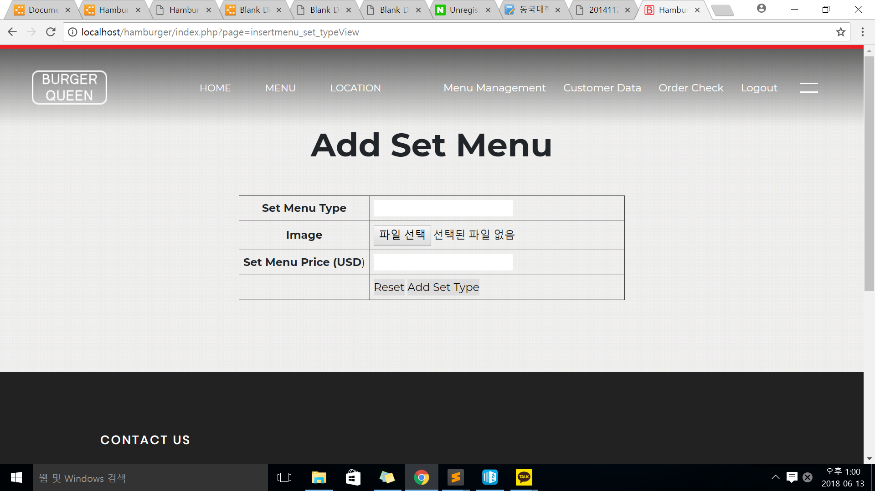
04
UI (Admin)
2. Menu management
* You can enter only numbers in the Price box.

Slide 19
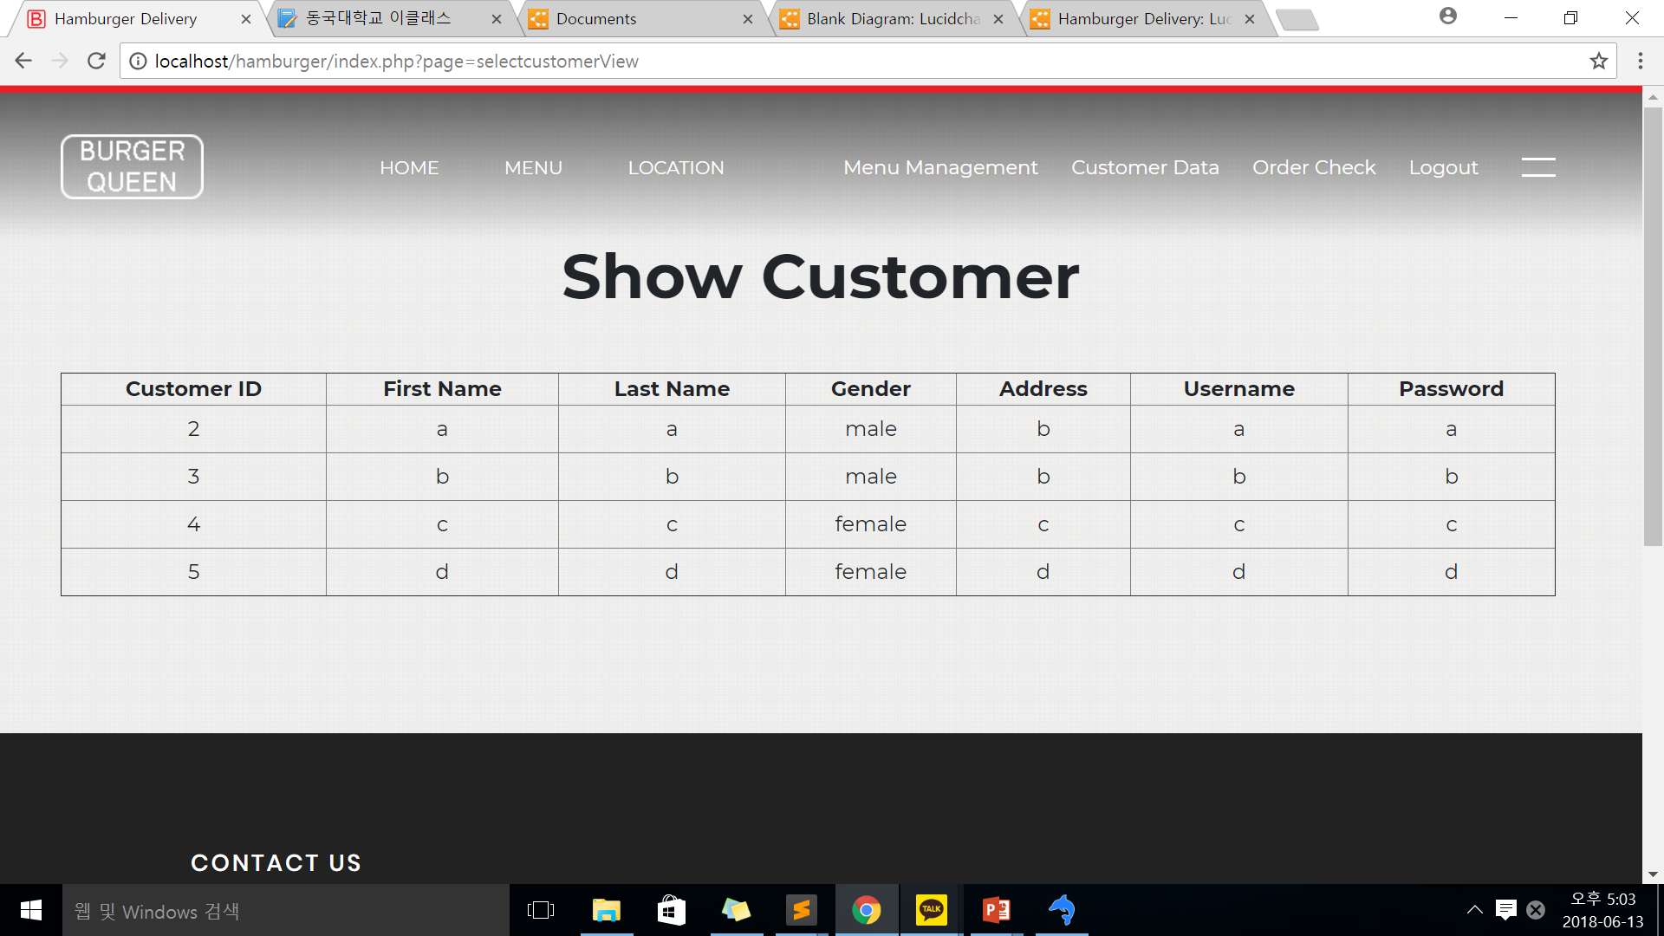
04
UI (Admin)
3. Customer data

Slide 20
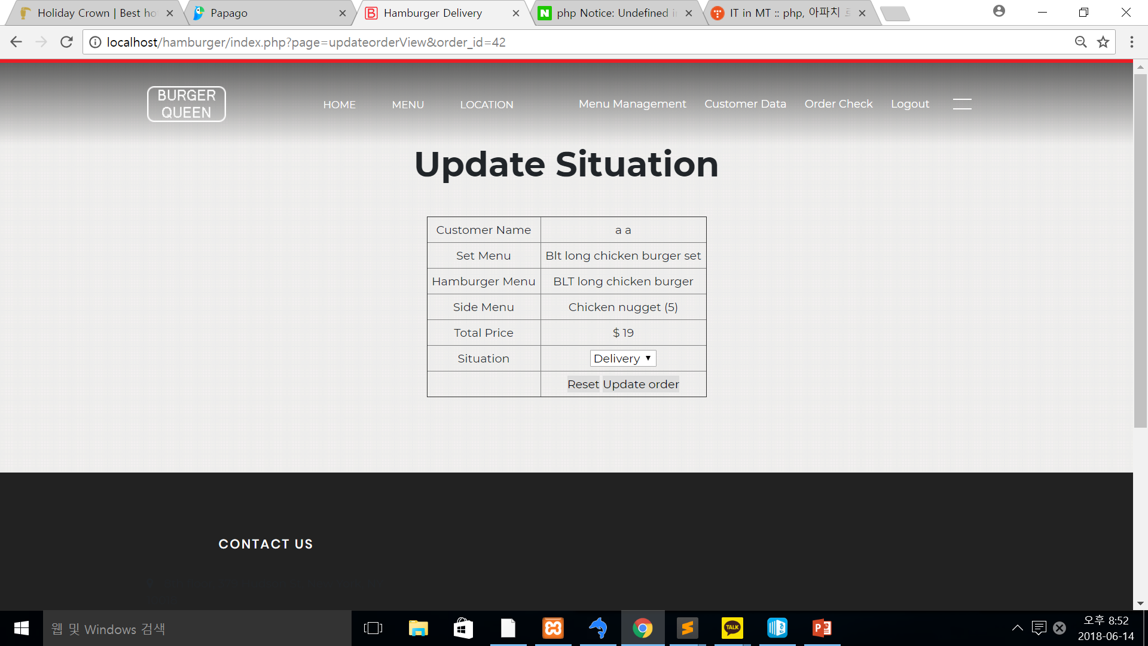
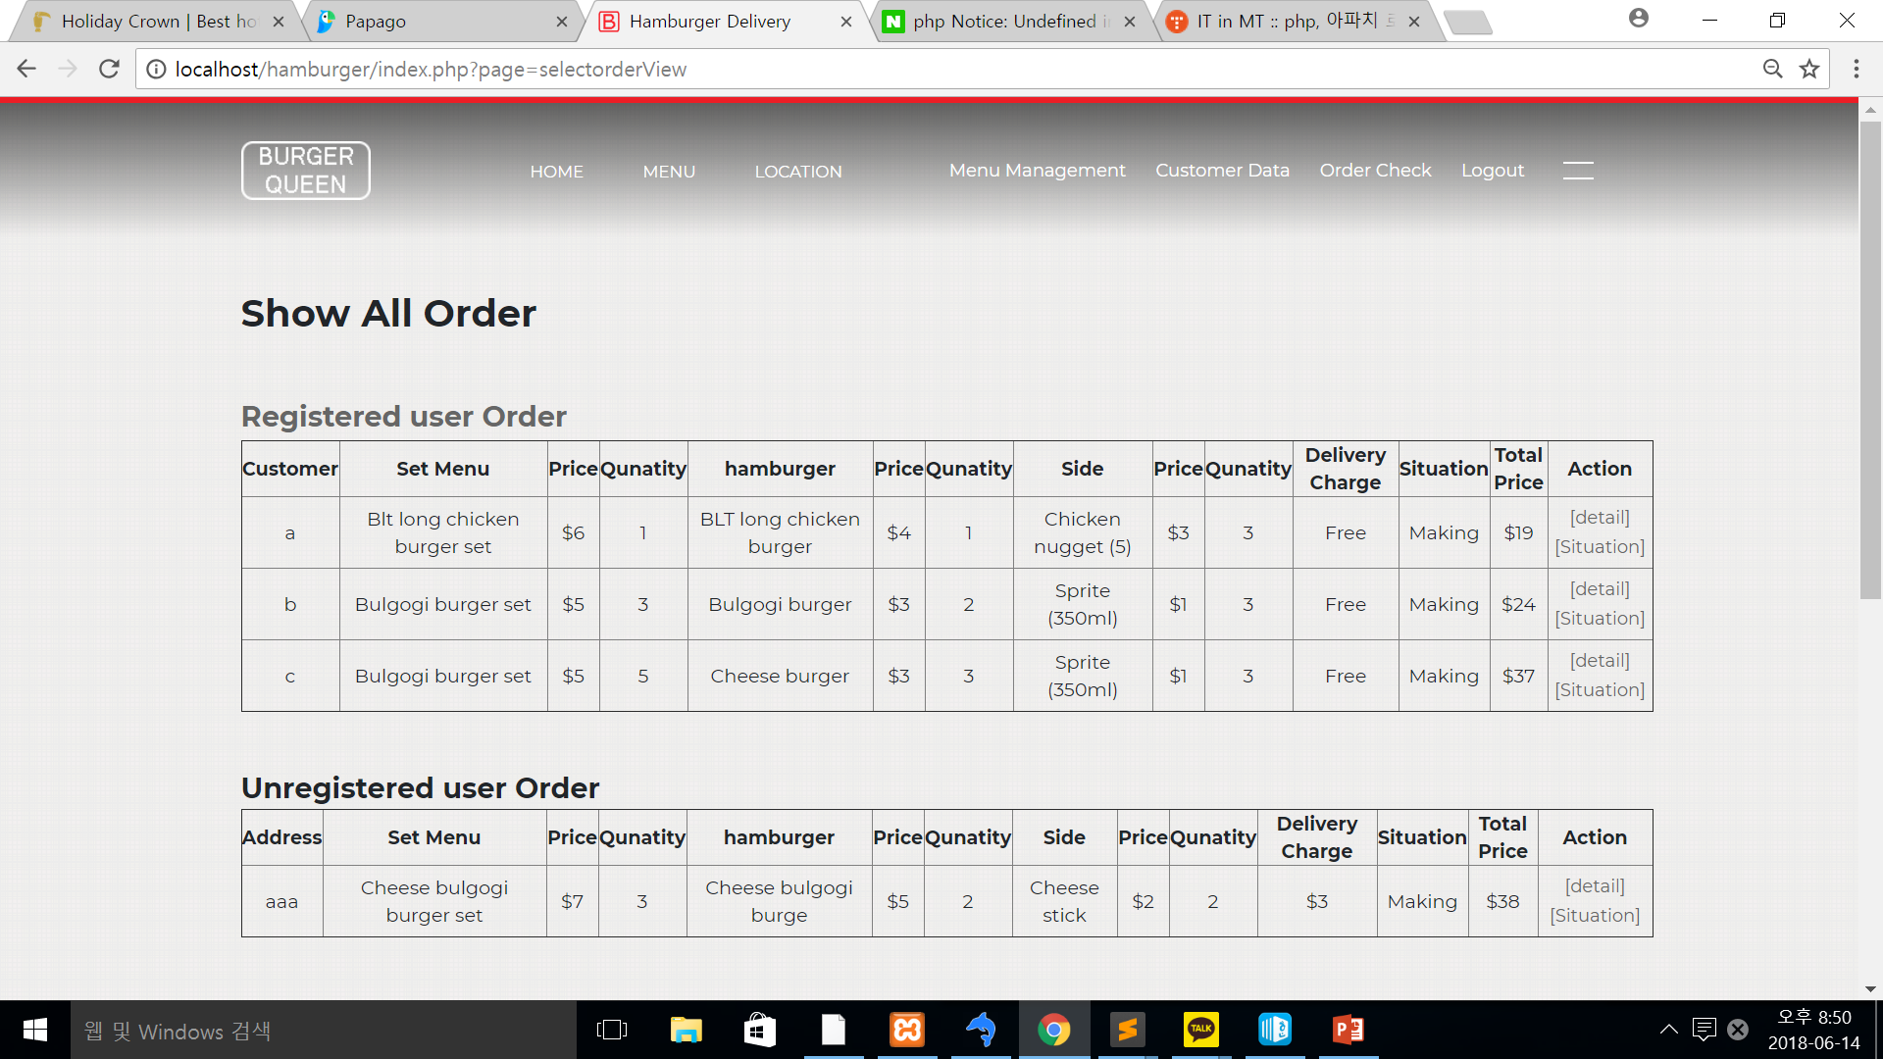
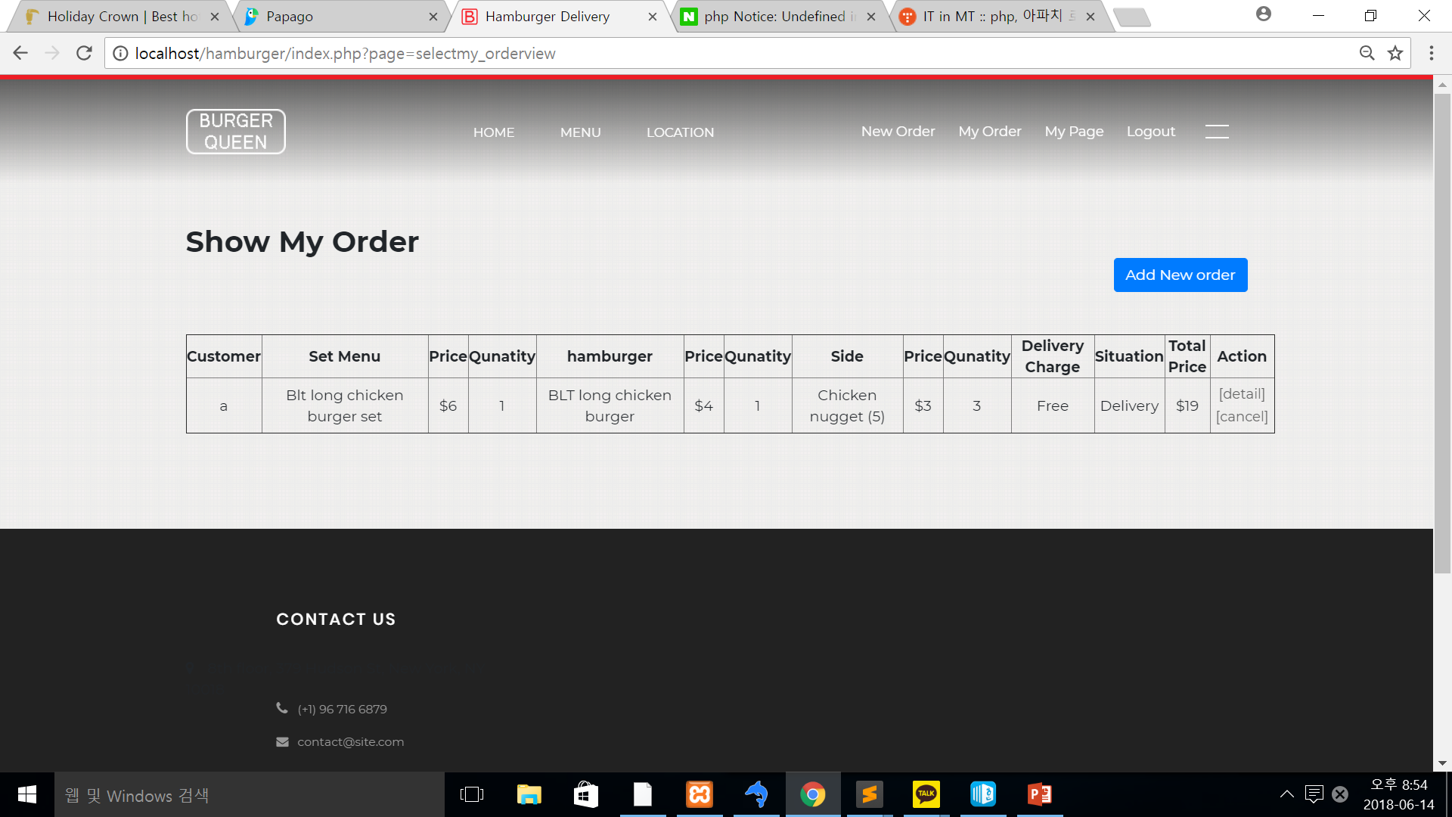
04
UI (Admin)
4. Order Check
* When customers see

Slide 21
THANK YOU

